Slide 1

Covid analysis Rate BY: Vaccination & Death (US States)
Lisa Charles

Slide 2
My Objective
With the recent rise in Covid-19 cases in the US, I felt the need to analyze the increasing rate of Covid infections and deaths in the US. I am hoping to show friends that are on the fence of getting vaccination how quickly and deadly the new strain of Covid is. I will be looking at Covid 19 vaccinations by State, hospitalizations and death rates. My goal is to find the correlation of death with fully vaccinated and non vaccinated persons.
To show through graphs and data resent Covid data
Hope I scare unvaccinated friends & family into rethinking vaccinations

Slide 3
Methodology
I will be analyzing data from two data sets from the following:
Dataset: Two data sets one will be looking at vaccinations by state the other will be looking at deaths and hospitalizations
Data Wrangling & Cleaning: We will be looking at two states with the highest vaccination rate and two with the lowest rates.
Filtering & Data Aggragation: We will create new variable with the states that we need and rename fields if needed and finally show the data.
Data Visulization: We will use Visualization Techniques to show death rates among the states with Highest vaccination rates and the states with the lowest rate and highest deaths.

Slide 4
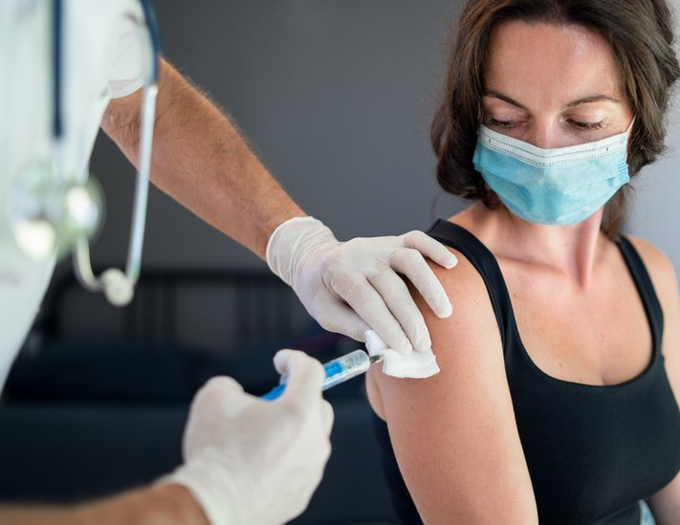
Data Sources used for Project
Https://covidtracking.com/data/download
https://data.cdc.gov/Case-Surveillance/United-States-COVID-19-Cases-and-Deaths-by-State-o/9mfq-cb36/data
https://data.cdc.gov/Case-Surveillance/United-States-COVID-19-Cases-and-Deaths-by-State-o/9mfq-cb36/data

Slide 5
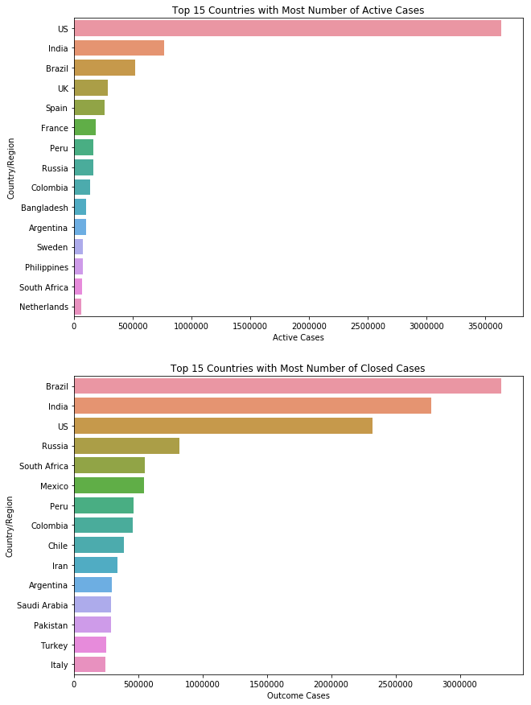

Slide 6
